Slide 1
Making applications Observable with OpenTelemetry
Johnathan Campos Senior Product Marketing Manager, Splunk

Slide 2



Industry Trends
Retain & Optimize
Lift & Shift
Re-Factor
Re-Architect / Cloud-Native
DEV
OPS
DEV
OPS
DEV
OPS
DEV
OPS
Cloud Managed e.g. RDS,
DynamoDB, SaaS
Cloud First Architecture
Tightly Coupled Apps,
Slow Deployment Cycles
Primarily using Cloud IaaS
More Modular, but Dependent App Components
Loosely Coupled Microservices, and Serverless Functions
VM
VM
VM
VM
VM
VM
VM
VM
VM
VM
VM
VM
VM
VM
VM
Private
Public
Private
Public
Private
Public
Notes:
Key Takeaways
Digital transformation is enabled by the cloud and cloud-native technologies
The reality is that most organizations have applications, environments and teams that span across multiple stages
Cloud is a key enabler of transformation now more so than ever. The financial, scalability and flexibility benefits are clear. Over the last couple of years, the conversation has moved from “should we move to the cloud” to “how do we do it in the right way?” And more importantly, “how do I maximize the investment that I’m making in cloud and making sure I have visibility into everything that is happening in the cloud?”
What we typically see is that companies migrate to the cloud in stages. They start by lifting & shifting their existing applications to cloud infrastructure. They then refactor their applications, breaking them up into smaller components, and finally they build cloud-native apps that leverage microservices and serverless functions.
And we find most importantly, the delivery models are changing from the siloed development and operations teams to joint development and operations or “DevOps” teams where there's a “you build it, you run it type” of mentality, where developers are responsible for supporting their code in production and are now on-call.
But the reality is that organizations often have multiple applications that fall into different or multiple stages of this journey. There is no one size fits all.

Slide 3
Monolithic Architecture
Microservices Architecture
Monitored Environment
Slow moving
Infrequently changed
Limited user transactions
Monitored Environment
Distributed services (10s to 100s)
Many hosts, Multi-Cloud
High transaction volume
Frequent code-pushes (CI/CD)

Slide 4
Latency is the new downtime.
Notes:
Dave

Slide 5
Monitoring Must Evolve into Observability
Observability helps detect, investigate and resolve the unknown unknowns – FAST
Monitoring
Observability
Keep an eye on things we know can go wrong
Find the unexpected and explain why it happened

Slide 6
O11y
“Observability”: You can’t operate what you can’t see

Slide 7
The first step in making your application observable is its telemetry

Slide 8
Being Observable is:
A strategy first
Instrumentation second
Observability configuration third

Slide 9
Getting Data In (GDI) should not rule Your Infrastructure
Tools should not dictate modernization
Velocity demands flexibility in monitoring
Scale cannot happen with snowflake GDI
Resilience requires standardized instrumentation

Slide 10
Terminology
Observability
Data sources all support the notion of resources
Traces: spans, span context (context propagation), attributes
Metrics: measurement, instrument, labels
Logs: log record, fields
https://opentelemetry.io/docs/concepts/glossary/

Slide 11

Tracing Basics
Context: W3C trace-context, B3, etc.
Tracer: get context
Spans: “call” in a trace
Kind: client/server, producer/consumer, internal
Attributes: key/value pairs; tags; metadata
Events: named strings
Links: useful for batch operations
Sampler: always, probabilistic, etc.
Span processor: simple, batch, etc.
Exporter: OTLP, Jaeger, Prometheus, etc.

Slide 12
Metric Basics
Context: span and correlation
Meter: used to record a measurement
Raw Measurement
Measure: name, description, unit of values
Measurement: single value of a measure
Metric: a measurement
Kind: counter, measure, observer
Label: key/value pair; tag; metadata
Aggregation
Time

Slide 13

History of Telemetry Data Collection
Monolith
Proprietary agent
Vendor lock-in
Hybrid
Open source agent
Vendor lock-in
Cloud Native
Open source agent
Open standards
Vendor agnostic
Notes:
Takeaway: the industry is moving to open source, open standard and vendor agnostic instrumentation and data collection. If we do not do it someone else will.
The industry is move right:
SFx/Splunk going all-in on Otel
Datadog donating auto-instrumentation to Otel
New Relic recently open-sourcing their instrumentation and data collection

Slide 14



OpenTelemetry Components
Specification
Instrumentation Libraries
Collector
API, SDK, Data
Single library per language for all signals
Receive, process, and export data

Slide 15
Introducing “OTel”
CNCF OSS project for GDI
Built on OpenTelemetry Standards
Implementation of Collector and Agent
A community

Slide 16
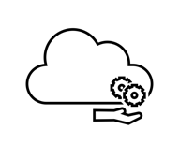
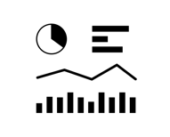
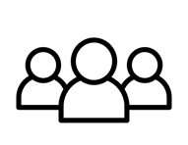
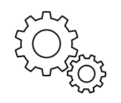
Everyone is Contributing and Adopting
Cloud Providers
Vendors
End-users
Other
AWS | Azure | GCP
Every major vendor!
Mailchimp (PHP) Postmates (Erlang) Shopify (Ruby)
Jaeger > OtelCol Fluent-bit < 3 log SIG Envoy roadmap OpenMetrics roadmap
https://github.com/open-telemetry/community/blob/master/ADOPTERS.md https://medium.com/jaegertracing/jaeger-embraces-opentelemetry-collector-90a545cbc24
Notes:
Why: everyone coming together to solve a common pain point.
Note: images from the Noun Project -- pro license purchased.

Slide 17
But why?
Offload responsibility from the application
Compression
Encryption
Retry
Tagging / Redaction
Vendor-specific exporting
Control flow of data
Time-to-value
Language-agnostic; makes changes easier
Set it and forget it; instrumentation that is ready for the Collector
Vendor-agnostic and easily extensible

Slide 18
Objectives
The OpenTelemetry Collector offers a vendor-agnostic implementation on how to receive, process, and export telemetry data in a seamless way.
Usable: Reasonable default configuration, supports popular protocols, runs and collects out of the box.
Performant: Highly performant under varying loads and configurations.
Observable: An exemplar of an observable service.
Extensible: Customizable without touching the core code.
Unified: Single codebase, deployable as an agent or collector with support for traces, metrics, and logs (future).

Slide 19
OpenTelemetry Collector
A vendor-agnostic implementation on how to receive, process, and export telemetry data in a seamless way
A single binary that can be deployed in a variety of different way (e.g. agent or gateway)
The default destination for OpenTelemetry client library data
https://opentelemetry.io/docs/collector/
https://opentelemetry.io/docs/collector/about/

Slide 20
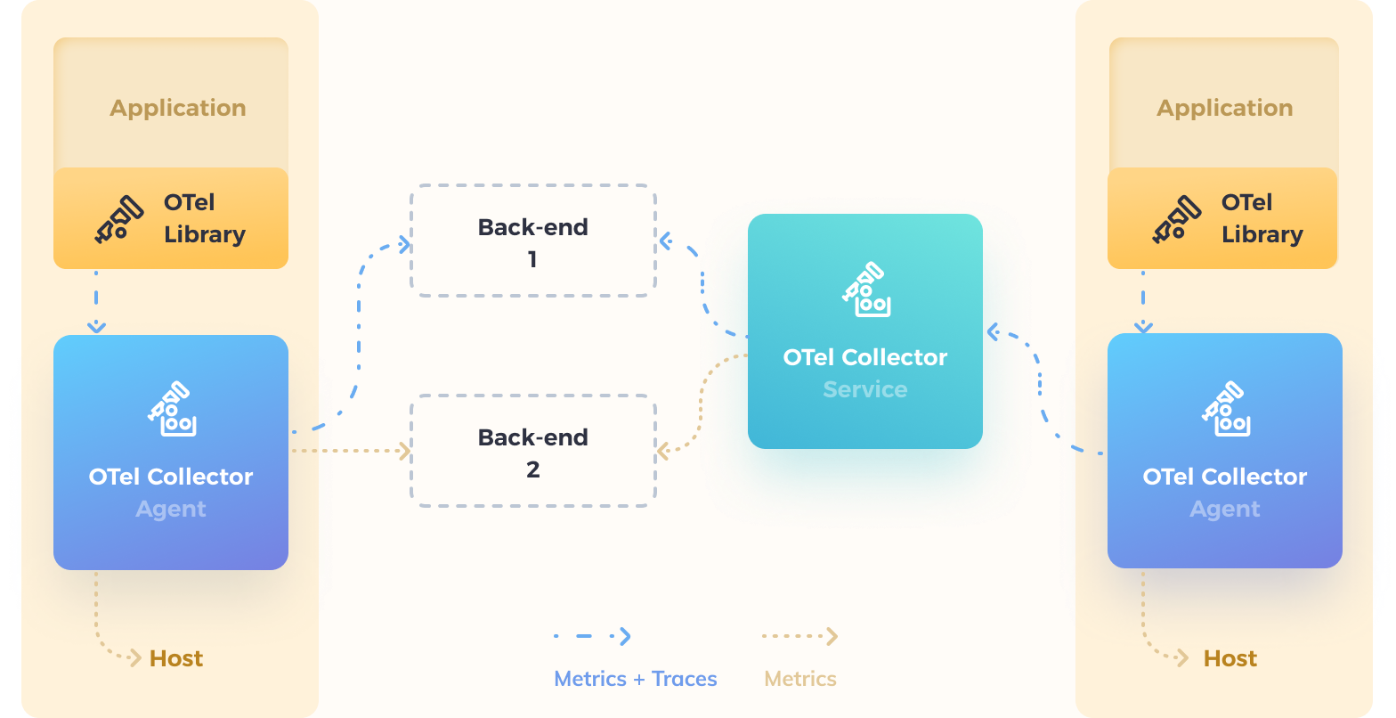
Reference architecture

Slide 21
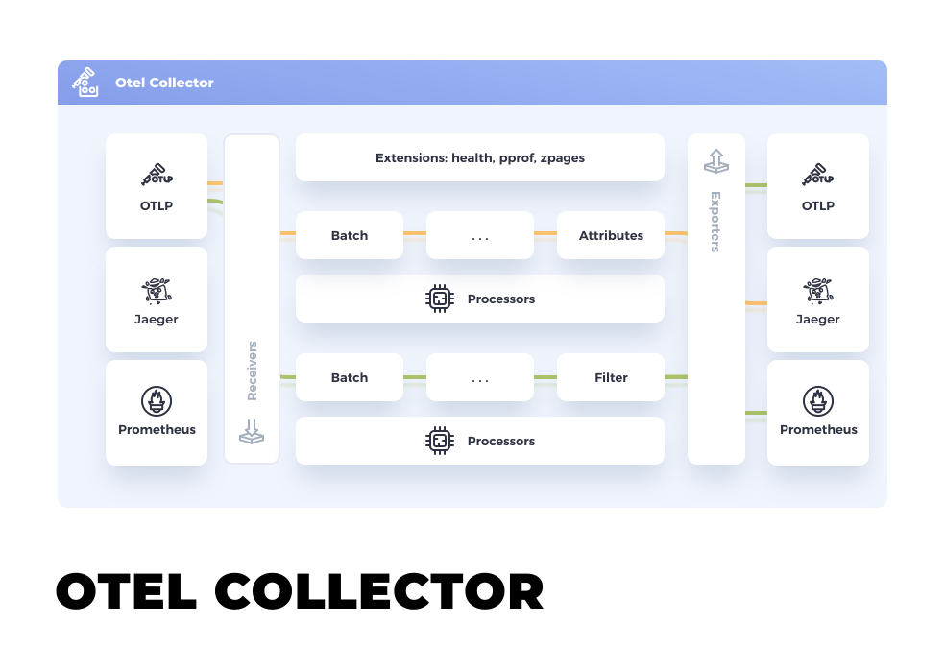
How is the OTel Collector architected?
https://opentelemetry.io/docs/collector/
Components
Receivers: how you get data in (can be push or pull-based)
Processors: what you to do the data (e.g. batching, metadata, etc.)
Exporters: how you get data out (can be push or pull-based)
Extensions: things you do in the collector typically outside processing data (e.g. health check)
Configuration is done in YAML and consists of two steps:
Define component configuration
Enable the component
Notes:
A vendor-agnostic implementation on how to receive, process, and export telemetry data in a seamless way
A single binary that can be deployed in a variety of different way (e.g. agent or gateway)
The default destination for OpenTelemetry instrumentation library data

Slide 22
Architecture
receivers:
sapm:
processors:
batch:
exporters:
sapm:
access_token: YOUR_TOKEN
endpoint: https://ingest.us0.signalfx.com/v2/trace
signalfx:
access_token: YOUR_TOKEN
realm: us0
service:
pipelines:
metrics:
receivers: [splunk-otel]
processors: [batch]
exporters: [splunk-otel]
traces:
receivers: [sapm]
processors: [batch]
exporters: [sapm]
Notes:
Why: Every use-case is slightly different. You have choice and can change at any time. Changes are done via configuration not code. Extensible architecture so easy to extend as needed.

Slide 23
Getting Started
Traces
Instantiate a tracer
Create spans
Enhance spans
Configure SDK
Metrics
Instantiate a meter
Create metrics
Enhance metrics
Configure observer

Slide 24

Getting Started: Traces (Automatic)
java -javaagent:path/to/opentelemetry-auto-<version>.jar \
-Dota.exporter.jar=path/to/opentelemetry-auto-exporters-otlp-<version>.jar \
-Dota.exporter.otlp.endpoint=localhost:55680 \
-Dota.exporter.otlp.service.name=shopping \
-jar myapp.jar
Instruments known libraries with no code (only runtime) changes
Adheres to semantic conventions
Configurable via environment and/or runtime variables
Can co-exist with manual instrumentation
WARNING: Do not use two different auto-instrumentation solutions on the same service.

Slide 25
Getting Started: Traces (Manual)
# Instantiate tracer
Tracer tracer =
OpenTelemetry.getTracer("instrumentation-library-name","semver:1.0.0");
# Create span
Span span = tracer.spanBuilder("my span").startSpan();
try (Scope scope = tracer.withSpan(span)) {
// your use case
# Enhance span
span.setAttribute("version", "1.2");
} catch (Throwable t) {
Status status = Status.UNKNOWN.withDescription("Change it to your error message");
span.setStatus(status);
} finally {
span.end(); // closing the scope does not end the span, this has to be done manually
}

Slide 26
Getting Started: Traces (Manual)
# Instantiate tracer
Tracer tracer =
OpenTelemetry.getTracer("instrumentation-library-name","semver:1.0.0");
# Create span
Span span = tracer.spanBuilder("my span").startSpan();
try (Scope scope = tracer.withSpan(span)) {
// your use case
# Enhance span
span.setAttribute("version", "1.2");
} catch (Throwable t) {
Status status = Status.UNKNOWN.withDescription("Change it to your error message");
span.setStatus(status);
} finally {
span.end(); // closing the scope does not end the span, this has to be done manually
}

Slide 27
Getting Started: Traces (Manual)
# Instantiate tracer
Tracer tracer =
OpenTelemetry.getTracer("instrumentation-library-name","semver:1.0.0");
# Create span
Span span = tracer.spanBuilder("my span").startSpan();
try (Scope scope = tracer.withSpan(span)) {
// your use case
# Enhance span
span.setAttribute("version", "1.2");
} catch (Throwable t) {
Status status = Status.UNKNOWN.withDescription("Change it to your error message");
span.setStatus(status);
} finally {
span.end(); // closing the scope does not end the span, this has to be done manually
}

Slide 28
Getting Started: Metrics
// Instantiate a meter
Meter meter = OpenTelemetry.getMeter("instrumentation-library-name","semver:1.0.0");
// Create a metric
LongCounter counter = meter
.longCounterBuilder("processed_jobs")
.setDescription("Processed jobs")
.setUnit("1")
.build();
// Configure observer
observer.setCallback(
new LongObserver.Callback<LongObserver.ResultLongObserver>() {
@Override
public void update(ResultLongObserver result) {
// long getCpuUsage()
result.observe(getCpuUsage(), "Key", "SomeWork");
}
});

Slide 29
Links
Specification
https://github.com/open-telemetry/opentelemetry-specification
OpenTelemetry Collector
https://opentelemetry.io/docs/collector/configuration/
Other
CNCF Demo – https://www.youtube.com/watch?v=31poMDrZSug
Tags Webinar - https://www.youtube.com/watch?v=XmUHhiVwCLA
Blog Post - https://bit.ly/3fvvCtG
https://opentelemetry.io/docs/workshop/resources/
https://devstats.cncf.io/
https://github.com/open-telemetry/community#special-interest-groups
Gitter: open-telemetry/opentelemetry-service

Slide 30
Thank You

